Slide 1
Automated Attendance System using RFID and Face Recognition
Team Members:
1.Naveen Kumar Singh (1614313048)
2.Satyendra Kushwaha (1614313069)
3.Prafull Deep Sahu (1614313057)
IT-2(4th year)
Mentor Name: Mr. Updesh Jaiswal

Slide 2
Concept Requirement
Python
MySql
php
Bootstrap
Java

Slide 3
Abstract
Automatic face recognition (AFR) technologies have made many improvements in the changing world. Smart Attendance using Real-Time Face Recognition is a real-world solution which comes with day to day activities of handling student attendance system.
Face recognition-based attendance system is a process of recognizing the students face for taking attendance by using face biometrics based on high - definition monitor video and other information technology.
In my face recognition project, a computer system will be able to find and recognize human faces fast and precisely in images or videos that are being captured through a surveillance camera. Numerous algorithms and techniques have been developed for improving the performance of face recognition but the concept to be implemented here is Deep Learning.
It helps in conversion of the frames of the video into images so that the face of the student can be easily recognized for their attendance so that the attendance database can be easily reflected automatically.

Slide 4
Problem Statement
Typically students attendance is marked by the professors manually which spends a lot of time causing in wastage of lecture. Also amount of proxies gets recorded in manual system. This can be substituted with computerized system.
The RFID will mark attendance robotically when student’s tag is passed through the scanner and student is enters the class. While face recognition will assist in validating student and marking the attendance of that individual student ensuring avoidance of proxies.

Slide 5
Objective
To develop web interface platform for Automated Attendance System using face Recognition and RFID and avoiding the time of marking attendance during lectures.

Slide 6
Algorithm Implementation
Face Database
Eigenfaces
Fisherfaces.

Slide 7
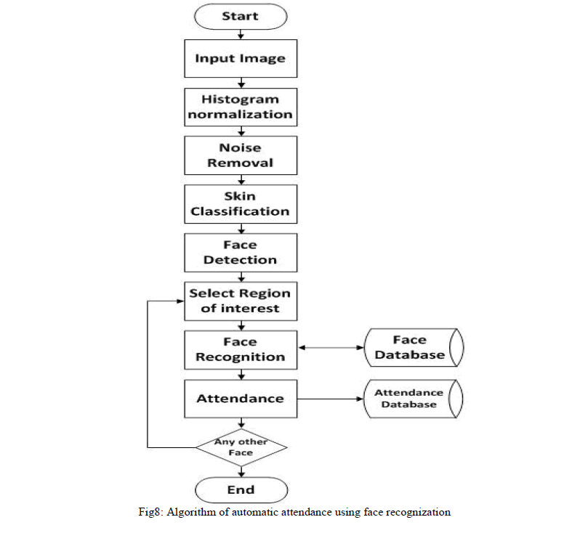
.

Slide 8
Literature Survey
We now think of some as basic analyses which represent the coordinating execution of eigenface method for face acknowledgment. We figure the execution of these methods when the foundation is known and the lightning conditions remains practically unaltered. The experiment consist of two phases:
Training phase: Here we make a training set of faces.
Recognition phase:
Here the trained faces are identified. The experiment consist a trial set of 4 different persons. The Experiment was conducted with 100 trials and the accurate trials are noted down. We considered 4 different sample faces including faces of Chaitanya, Anis, Aniket and Sagar.
Three tables are given here with the experiment results. The Table 1 records the details in which training is done only once whereas in Table 2 the training is done 4 times and in Table 3 the training set is 8.

Slide 9
Student Name | No. of training images | No. of trials conducted | No. of Trials Succeeded | % Accuracy
Anil | 1 | 20 | 5 | 25
Suresh | 1 | 20 | 4 | 20
Rahul | 1 | 20 | 6 | 30
Mukesh | 1 | 20 | 8 | 40
Student Name | No. of training images | No. of trials conducted | No. of Trials Succeeded | % Accuracy
Anil | 4 | 20 | 10 | 50
Suresh | 4 | 20 | 13 | 65
Rahul | 4 | 20 | 11 | 55
Mukesh | 4 | 20 | 14 | 70

Slide 10
Student Name | No. of training images | No. of trials conducted | No. of Trials Succeeded | % Accuracy
Anil | 8 | 20 | 17 | 85
Suresh | 8 | 20 | 18 | 90
Rahul | 8 | 20 | 16 | 80
Mukesh | 8 | 20 | 18 | 90

Slide 11


Snapshots

Slide 12


Slide 13


Slide 14

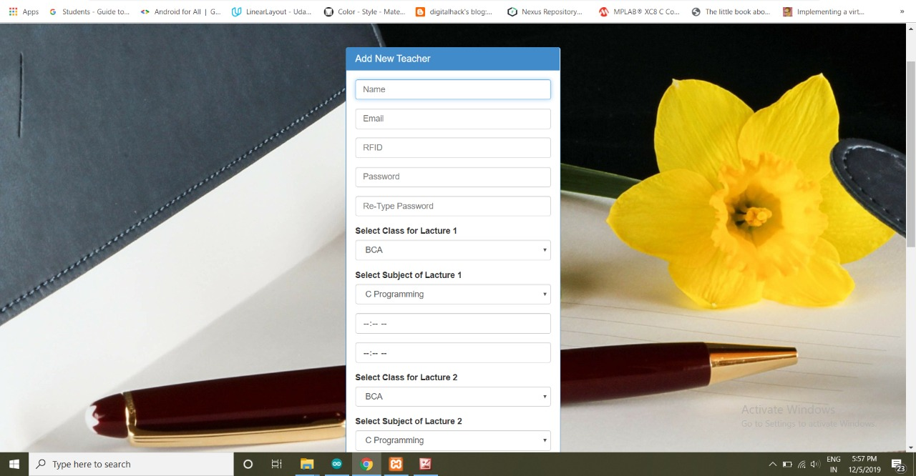

Slide 15
Scope And Limitations
Scope
Generally, we are using Haar’s Classifier and Eigen face identifier in combination, but in near future, to enhance the accuracy and performance of face recognition we can use PIFR (Pose Invariant Face Recognition) along with high.
Limitation
The main limitation of this project is that if one’s attendance is missing on that day of any lectures then the attendance can’t be uploaded on next day.

Slide 16
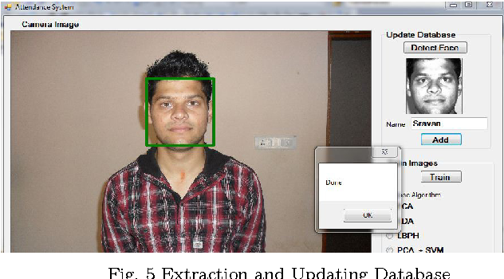
Extraction and Updating of database

Slide 17
Conclusion
This paper symbolizes a student’s attendance system via RFID and Face Recognition. Typically students attendance is marked by the professors manually which spends a lot of time causing in wastage of lecture. Also amount of proxies gets recorded in manual system.
This can be substituted with computerized system. RFID will mark the attendance robotically when student’s tag is passed through the scanner and student is enters the class. While face recognition will assist in validating student and marking the attendance of that individual student ensuring avoidance of proxies.

Slide 18
References
Chung-Hao Huang, Lun-Hui Lee, Chian C. Ho, Lang- Long Wu, and Zu-Hao Lai “Real-Time RFID Indoor Positioning System Based on Kalman-Filter Drift Removal and Heron-Bilateration Location Estimation”, IEEE TRANSACTIONS ON INSTRUMENTATION AND MEASUREMENT, VOL. 64, NO. 3 MARCH 2015.
2. Changxing Ding,ChangXu, Dacheng Tao “Multi-task Pose-Invariant Face Recognition”, IEEE TRANSACTIONS ON IMAGE PROCESSING, VOL. 24, NO. 3 MARCH 2015.
3. Angus F. C. Errington, Brian L. F. Daku, and Arnfinn F. Prugger “Initial Position Estimation Using RFID Tags: A Least-Squares Approach”, IEEE TRANSACTIONS ON INSTRUMENTATION AND MEASUREMENT, VOL. 59, NO. 11, NOVEMBER 2010.
4. Ali AsgharNazariShirehjini, AbdulsalamYassine, and ShervinShirmohammadi “An RFID-Based Position and Orientation Measurement System for Mobile Objects in Intelligent Environments”, IEEE TRANSACTIONS ON INSTRUMENTATION AND MEASUREMENT, VOL. 61, NO. 6, JUNE 2012.
5. ] Ricardo Tesoriero, José A. Gallud, María D. Lozano, Víctor M. R. Penichet “Tracking Autonomous Entities using RFID Technology”, IEEE Transactions on Consumer Electronics, Vol. 55, No. 2, MAY 2009.
6. Ilkovicova, Ľ., Erdelyi, J. and Kopacik, A.] “Positioning in Indoor Environment using QR Codes”, INGEO 2014 – 6th International Conference on Engineering Surveying Prague, Czech republic, April 3-4, 2014.
7. Chia-Hsin Cheng, Wei-JiaLuo, Yeh-Wei Lin and Chi-Chia Sun Department of Electrical Engineering, National Formosa University, Taiwan “Position Location Techniques in Wireless Sensor Networks Using Reference Node Algorithm”, 2013 IEEE 17th International Symposium on Consumer Electronics (ISCE).
8. Rabia Jafri and Hamid R. Arabnia “A Survey of Face Recognition Techniques”, Journal of Information Processing Systems, Vol.5, No.2, June 2009.

Slide 19
References
Portraits of Automated FacialRegognition On Machinic Ways of Seeing the Face Lila Lee-Morrison
The 2021-2026 World Outlook for facial Recognition Philip M. Parker Ph.D https://www.matrixaccesscontrol.com/request-a-quote/?gclid=CjwKCAjwte71BRBCEiwAU_V9h6-11C2mDR7PJQ6jXnMLz_6ihMexc-0Eh_6Lhf5SrBaMITMFNmzWExoCpZUQAvD_BwE

Slide 20


